Slide 1



Customer Retention- Case Study
Durgadhar Pathak
Internship 15

Slide 2
“Those who can imagine anything, can create the impossible.”
- Alan Turing

Slide 3
Problem Statement
Customer retention:- Customer retention refers to a company’s ability to turn customers into repeat buyers and prevent them from switching to a competitor. It indicates whether your product and the quality of your service please your existing customers. It’s also the lifeblood of most subscription-based companies and service providers.
Customer retention benefits:-
1- Cost savings: Customer retention is generally more cost-effective than acquiring first-time customers.
2- Positive word of mouth marketing: Loyal customers are more likely to tell their friends and family about your brand.
3- A better bottom line: Increasing retention rates by just 5 percent can increase revenue by 25 percent to 95 percent.

Slide 4
Motivation & Understanding
Motivation:- Since e-commerce growth has been significant so far at each industry for the last couple of years, understanding the customer who purchase your product and their journey post order in the platform plays a crucial role for retaining a customer. From the dataset we got the feedback of each of the parameters for a customer and through the data analysis each significant parameter has been dig down and understand the deeper meaning of it. This project helps me understand the objective of customer feedback which at enterprise level has a greater focus.
Customer retention Strategy:-Customer retention strategies are the processes and initiatives businesses put in place to build customer loyalty and improve customer lifetime value. Customer retention is different from customer acquisition or lead generation. It focuses on customers who have already signed up for a service or purchased a product from you.
But retaining customers is about more than just transactions—it’s about relationships. Research shows that customers view their relationships with brands similarly to their relationships with friends. Customers like brands that are reliable, authentic, and aware of what matters to them.
If we want to create an effective customer retention strategy, it starts with understanding what our customers value and providing a product that matches. Focusing on buyer relationships with your existing customers will help in boost their brand loyalty. These shoppers will continue to choose our brand even when presented with other options. With this loyal base, our brand will be more likely to weather volatile markets.

Slide 5

E-Retail Success Factors
The data is collected from the Indian online shoppers. Results indicate the e-retail success factors, which are very much critical for customer satisfaction.

Slide 6
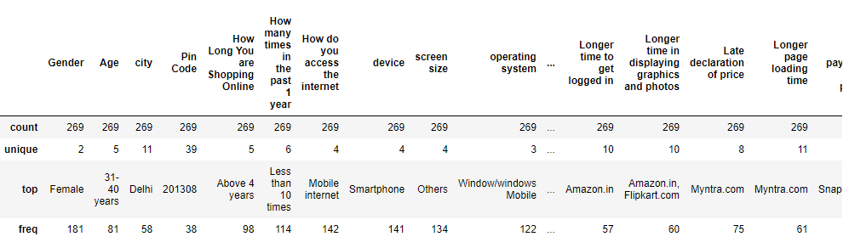
Statistical Summary
Summary Statistics is used to summarize set of observations, in order to communicate the largest amount of information as simply as possible. It includes central Tendency, dispersion, skewness, variance, range, deviation etc.

Slide 7
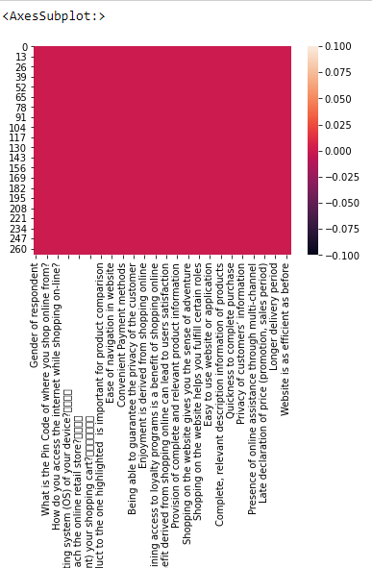
Missing Data
Missing Data: - Missing data are values that are not recorded in a dataset. They can be a single value missing in a single cell or missing of an entire observation. Missing data can occur both in a continuous variable or categorical variable. We had checked missing values in our dataset & dataset has no missing values.

Slide 8
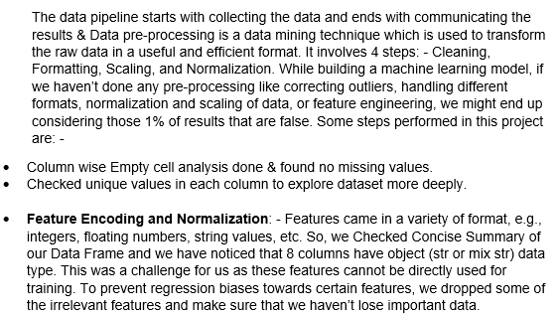
Data Pre-Processing

Slide 9
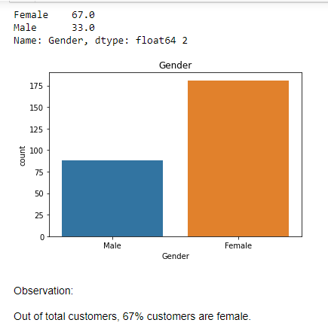
Data Visualizations
Data visualization is the graphical representation of information and data. We have checked visualizations for our input and output features in our dataset.
Customer Related Information:- 1- Count plot for " Gender" feature: -

Slide 10
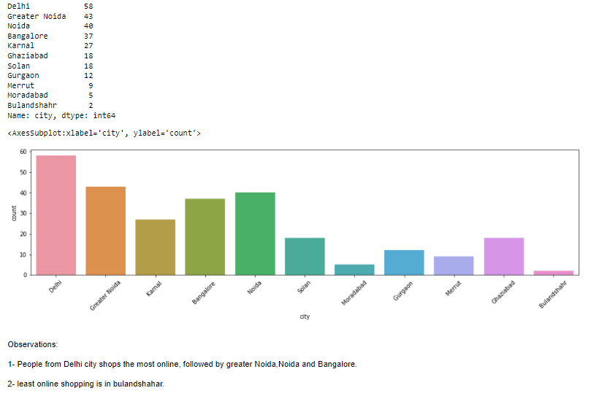
Data Visualizations
Data visualization is the graphical representation of information and data. We have checked visualizations for our input and output features in our dataset.
Customer Related Information:- 2- Count plot for " City" feature: -

Slide 11
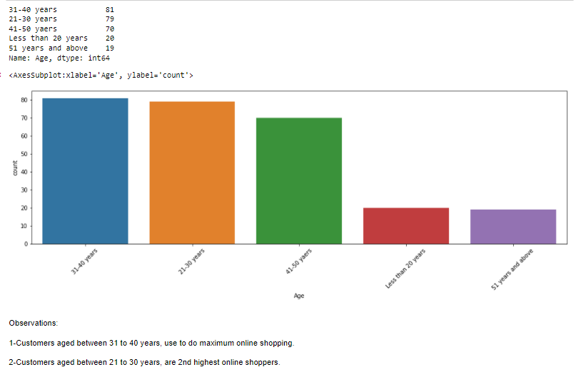
Data Visualizations
Data visualization is the graphical representation of information and data. We have checked visualizations for our input and output features in our dataset.
Customer Related Information:- 3- Count plot for “Age" feature: -

Slide 12
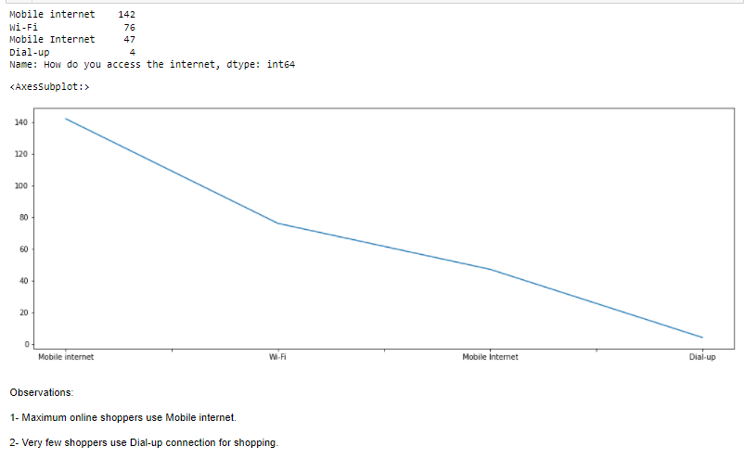
Data Visualizations
Data visualization is the graphical representation of information and data. We have checked visualizations for our input and output features in our dataset.
Customer Related Information:- 4- Line plot for “How do you access the internet" feature: -

Slide 13
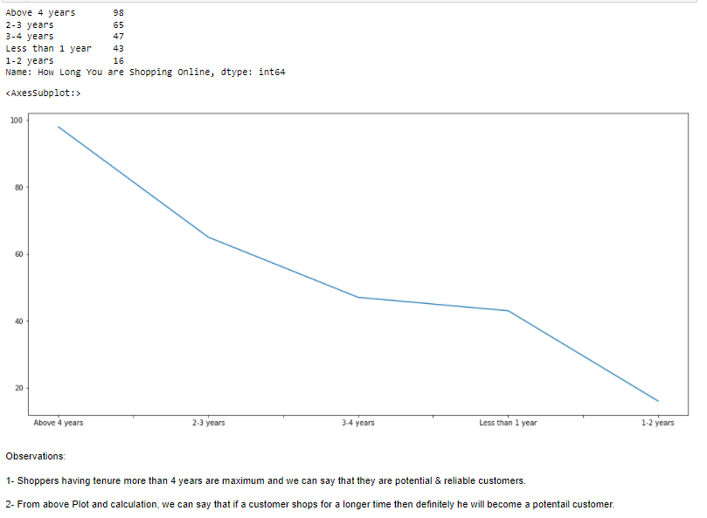
Data Visualizations
Data visualization is the graphical representation of information and data. We have checked visualizations for our input and output features in our dataset.
Customer Related Information:- 5- Line plot for “How Long You are Shopping Online" feature: -

Slide 14
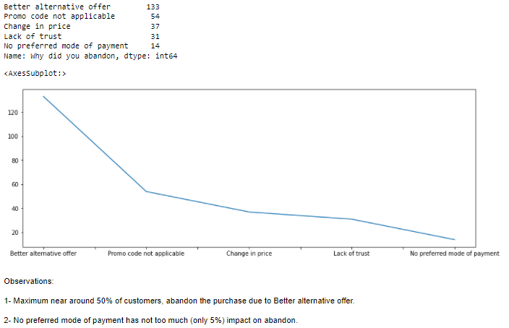
Data Visualizations
Data visualization is the graphical representation of information and data. We have checked visualizations for our input and output features in our dataset.
Customer Related Information:- 6- Line plot for “Why did you abandon" feature: -

Slide 15
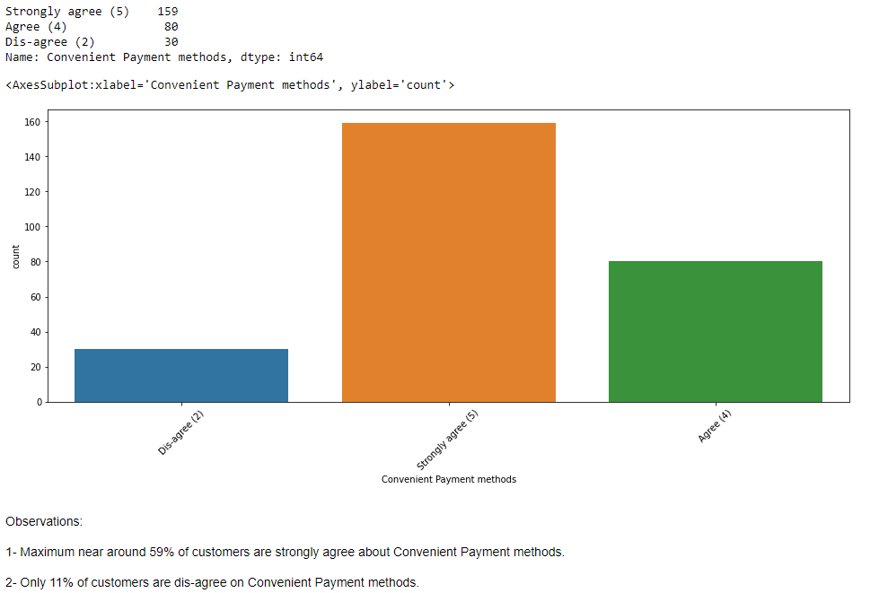
Data Visualizations
Data visualization is the graphical representation of information and data. We have checked visualizations for our input and output features in our dataset.
Customer Feedback Analysis:- 1- Count plot for "Convenient Payment methods" feature: -

Slide 16
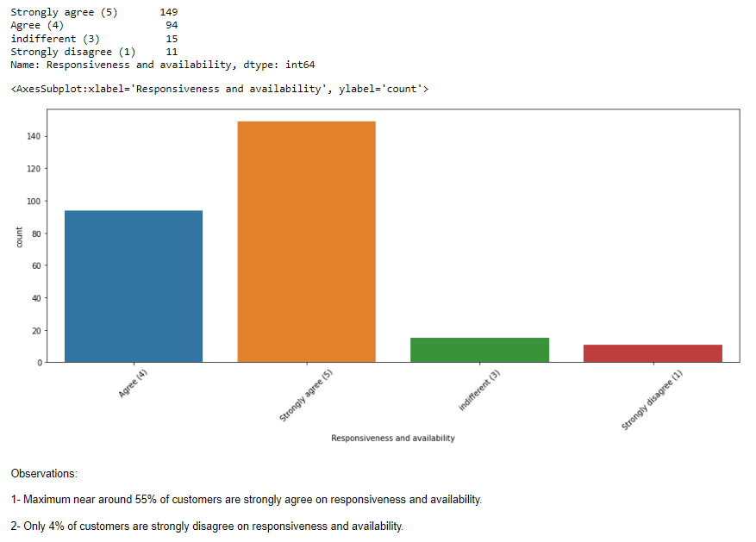
Data Visualizations
Data visualization is the graphical representation of information and data. We have checked visualizations for our input and output features in our dataset.
Customer Feedback Analysis:- 2- Count plot for "Responsiveness and availability" feature: -

Slide 17
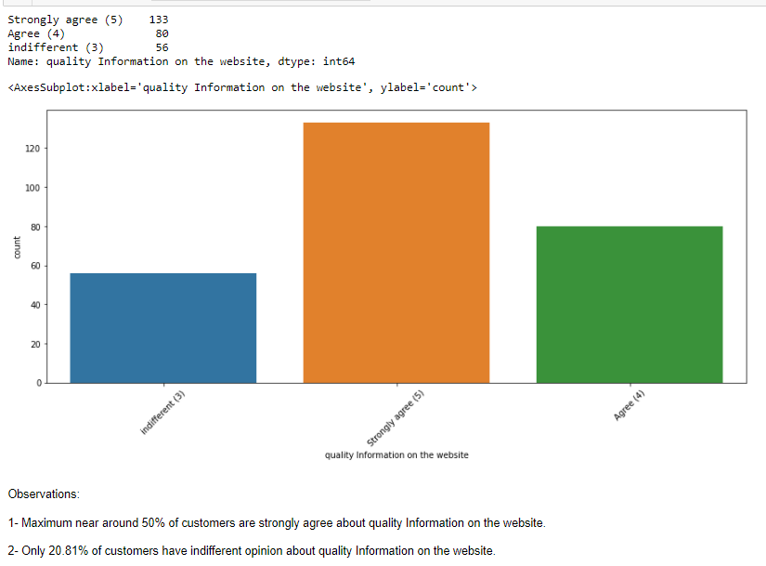
Data Visualizations
Data visualization is the graphical representation of information and data. We have checked visualizations for our input and output features in our dataset.
Customer Feedback Analysis:- 3- Count plot for "quality Information on the website" feature:-

Slide 18
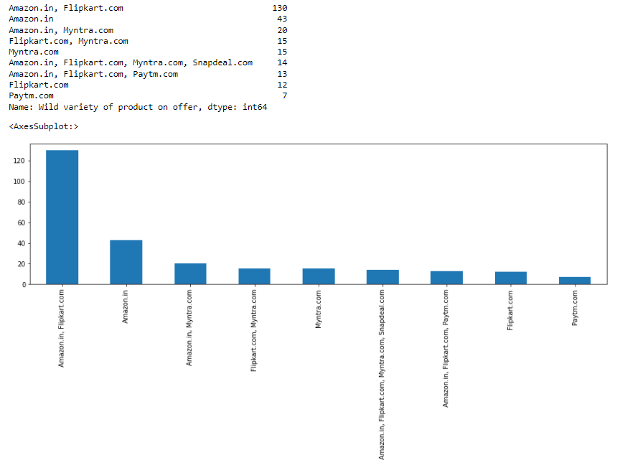
Data Visualizations
Data visualization is the graphical representation of information and data. We have checked visualizations for our input and output features in our dataset.
Shopping Platforms Analysis:- 1- Bar plot for "Wild variety of product on offer" feature:-

Slide 19
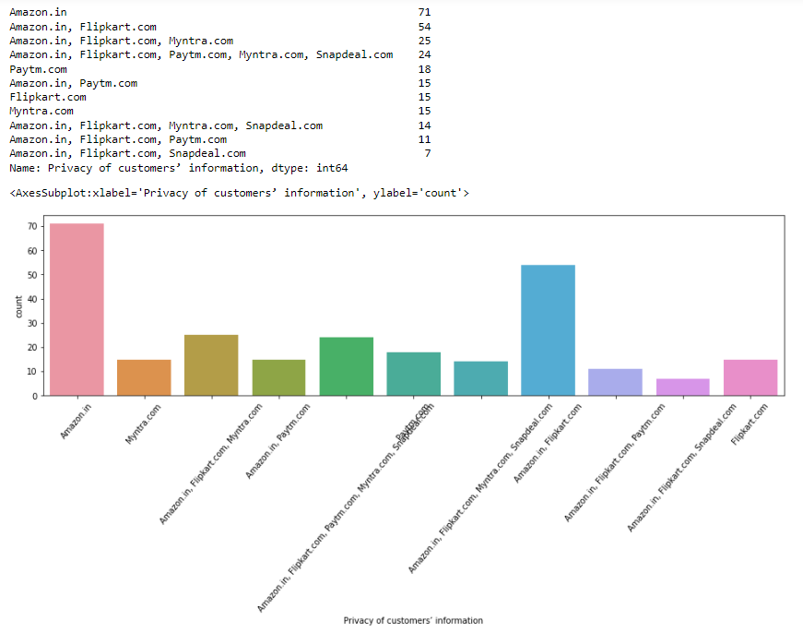
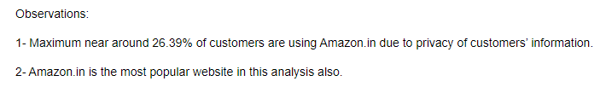
Data Visualizations
Data visualization is the graphical representation of information and data. We have checked visualizations for our input and output features in our dataset.
Shopping Platforms Analysis:- 2- Count plot for "Privacy of customers’ information" feature:-

Slide 20
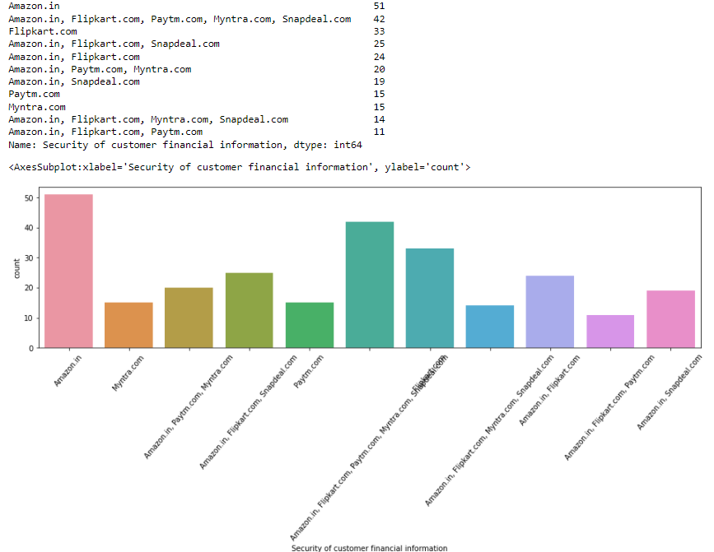
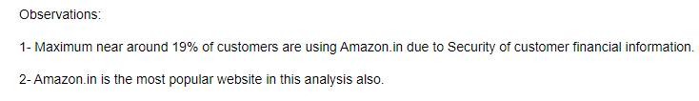
Data Visualizations
Data visualization is the graphical representation of information and data. We have checked visualizations for our input and output features in our dataset.
Shopping Platforms Analysis:- 3- Count plot for "Security of customer financial information" feature:-

Slide 21
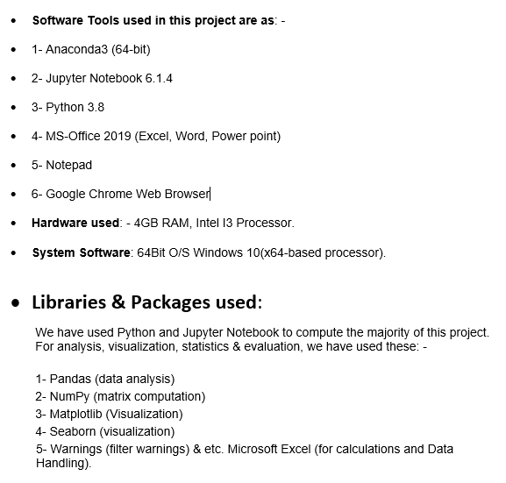
Software & Hardware Requirements and Tools used:-

Slide 22
Steps used in this Project
1- Define the Problem
2- Data Gathering
3- Data Cleaning
4- Data Exploration and Visualization
5- Descriptive Analysis
6- Finding conclusions in detailed data analysis & etc.

Slide 23
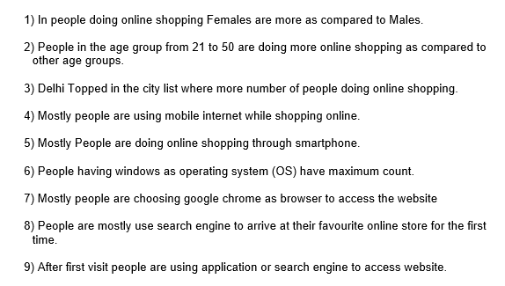
Conclusion on basis of Customer related Information:-

Slide 24
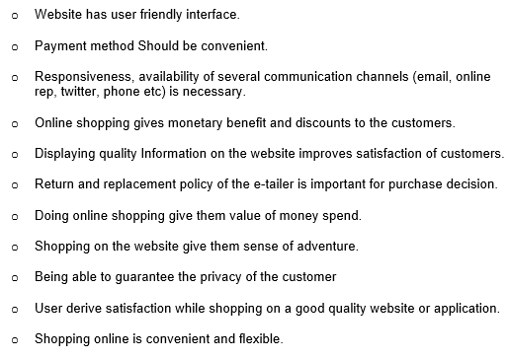
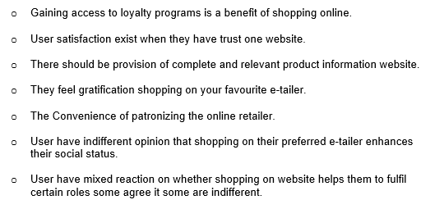
Conclusions from Customer Feedback Analysis:-

Slide 25
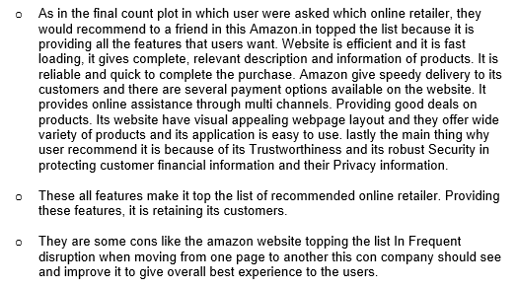
Conclusions from Detailed Data Analysis:-

Slide 26

Thank You

